Slide 1
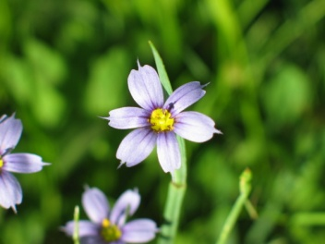
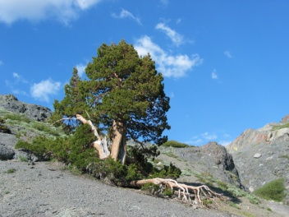
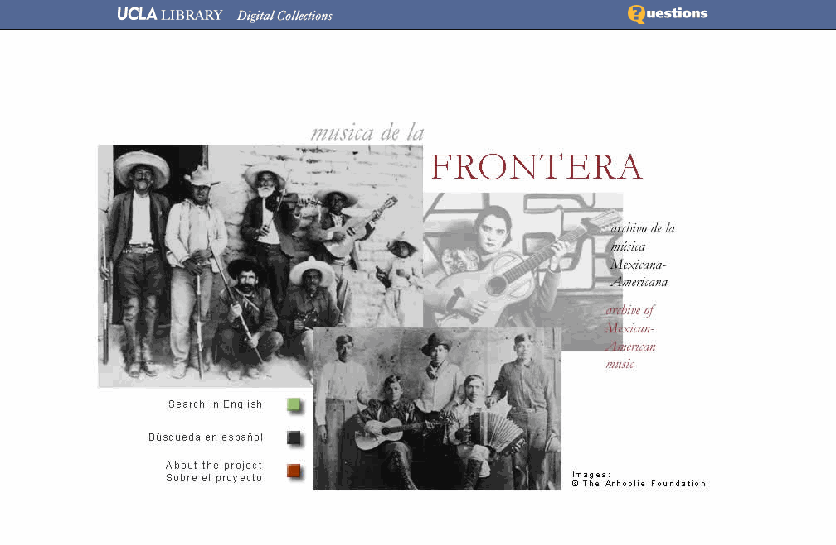


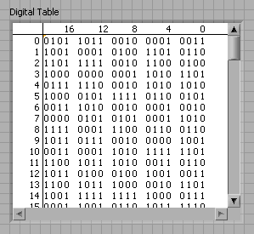
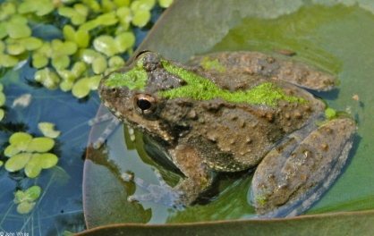
The University of California Curation Center (UC3)
A Plan for Curation Services:
Organization, Technologies, Communities
The Original NDIIPP Partners:
Plans for Moving Forward
Patricia Cruse, Director, UC3, CDL

Slide 2
The current landscape
Ever increasing number, size, and diversity of content
  More stuff, less resources
Ever increasing diversity of partners, stakeholders, and expectations
  Producers / consumers ⇨ prosumers / conducers
Inevitability of disruptive change
  Technology
  User expectation
  Institutional mission
Economic downturn
Work
$
Time
University of California Curation Center, California Digital Library
Notes:
How can we best respond organizationally?
How does our technical landscape change?
How can we build new communities?

Slide 3

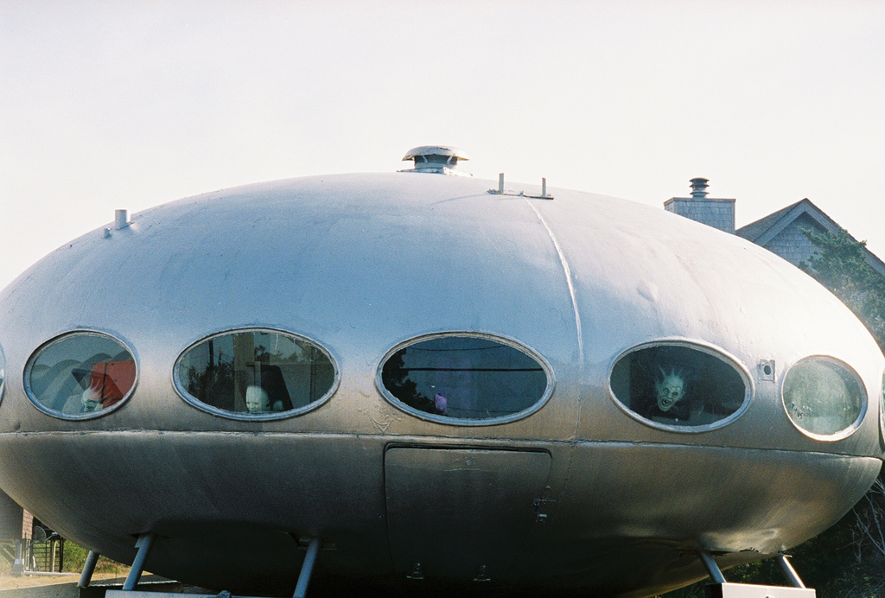
http://www.flickr.com/photos/outerbankscandy/79480040/

Slide 4
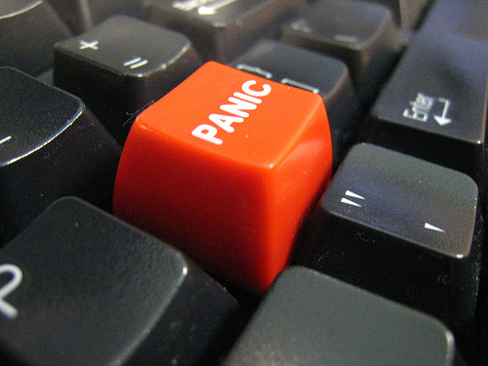
http://www.flickr.com/photos/johnjoh/448665548/

Slide 5
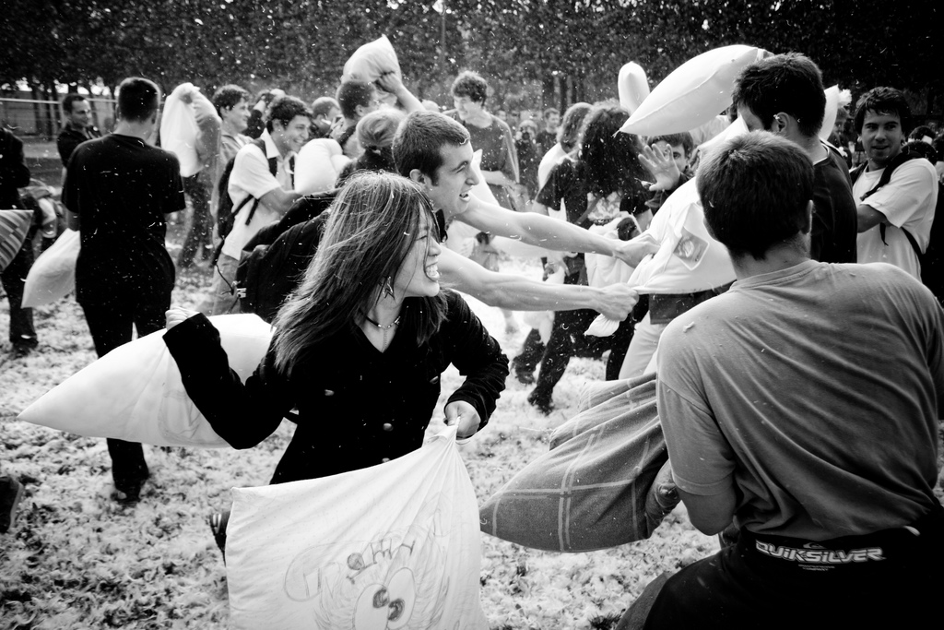
http://www.flickr.com/photos/philippeleroyer/2202178647/sizes/l/

Slide 6
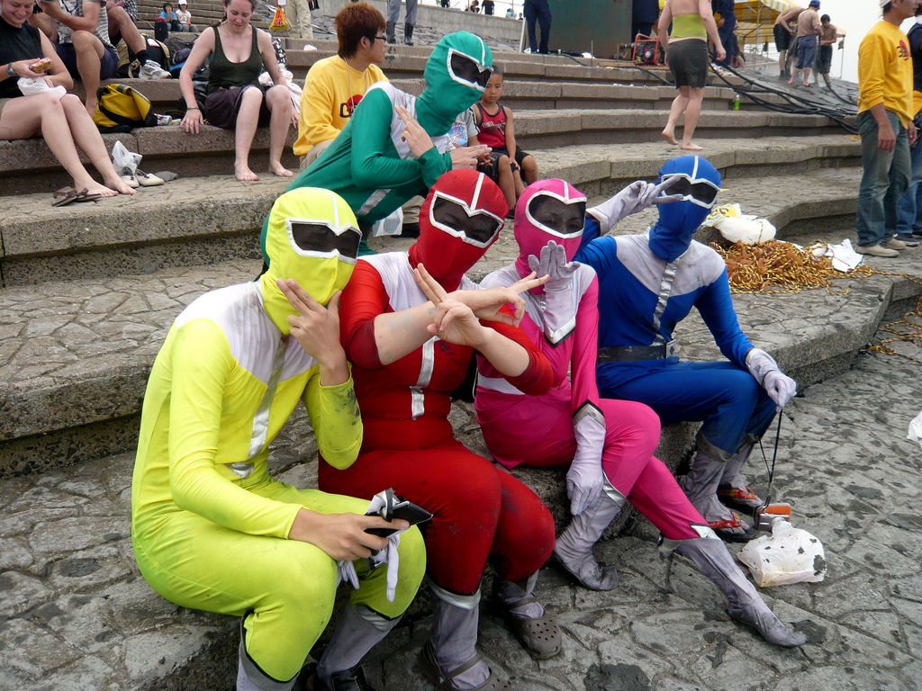
Collaborate
http://www.flickr.com/photos/healfdene/2580099594/

Slide 7

University of California Curation Center (UC3)
the 10 UC campuses and peer institutions in the digital curation community
An evolving community of shared concern and practice
A means to pool and distribute diverse experience, expertise, and resources
Robust solutions to counteract inevitable disruptive change
University of California Curation Center, California Digital Library

Slide 8
New Organization: UC3 is a creative partnership
UC Curation Center
Private sector
National / international libraries
Faculty / researchers
Research Units
Libraries
Museums
IT / Data Centers
Non-profit
Academic institutions
UC Community
External to the University

Slide 9
UC3’s dynamic technical approach
1. Work together to leverage/showcase existing solutions:
Chronopolis
Open Context (Archaeological data, NSF)
Media Vault Program
2. Build when necessary:
Micro-services -- decomposes function into a granular set of independent interoperable micro-services
small, self-contained, and narrowly scoped
easier to develop, maintain, and deploy
3. Partner and outsource when it makes economic sense
HathiTrust
Portico
University of California Curation Center, California Digital Library

Slide 10
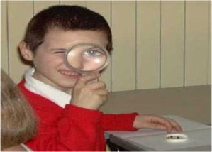











Organization, technology, & communities of practice = services meeting a range of needs
1. Consultation Services
2.
Hosted Solutions
3.
Campus Solutions
4. Partnerships
5. Community Initiatives
Expertise
Media Vault
Media Vault Program
Chronopolis
Curation microservices
Guidelines
Deployment of micro
services
Web Archiving Service
Best practices
Storage services

Slide 11
The challenge of the Web Archiving Service
Ithaka S+R Business Planning Activities
Reviewed competitive landscape
  market trends
  WAS’ position
Investigated current and potential user communities
Developed business planning priorities: 3 scenarios for the future
  users stakeholders
  costs
  benefits
  revenue
University of California Curation Center, California Digital Library

Slide 12
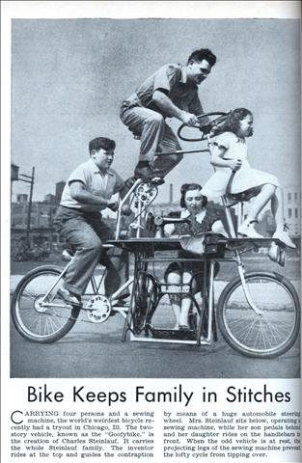
Biggest challenges how to respond
Embrace an entrepreneurial spirit
Be nimble
Respond to changing needs
Understand your costs
Be prepared to cut losses and recalibrate
Make friends and develop partnerships
University of California Curation Center, California Digital Library

Slide 13
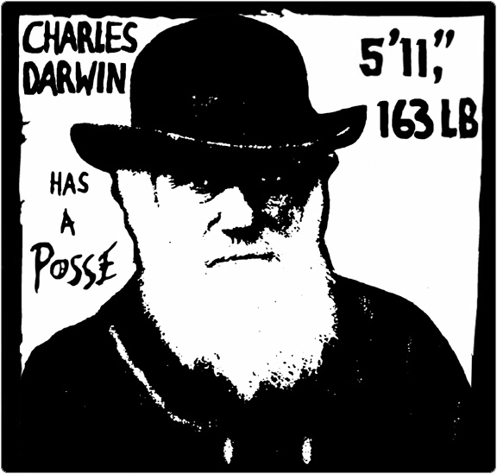
http://www.flickr.com/photos/cpurrin1/81055948/

