Slide 1
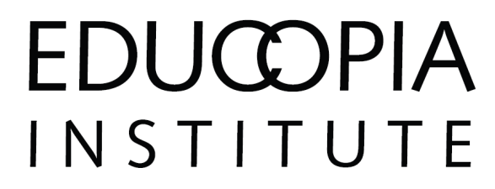
Modeling Interactions Between Repositories in the National Digital Stewardship Alliance
Toward a Distributed and Collaborative Framework for Preservation
Martin Halbert, UNT Dean of Libraries
David Minor, Chronopolis Program Manager
Katherine Skinner, Educopia Institute Executive Director
Wednesday, July 21, 2010
NDIIPP Partners Meeting 2010, Arlington, VA

Slide 2
Presentation Overview
Context of collaboration in the National Digital Stewardship Alliance
Field notes on organizational strategies and collaborative preservation models
Need to build on OAIS to create shared models/vocabulary for understanding inter-organizational content stewardship activities

Slide 3
National Digital Stewardship Alliance
A collaborative effort among:
  government agencies,
  educational institutions,
  non-profit organizations, and
  business entities
to preserve a distributed national digital collection
for the benefit of citizens now and in the future.
Source: NDIIPP 2010 Partners Meeting Handout

Slide 4
National Digital Stewardship Alliance (NDSA)
Collaborative relationships were core to NDIIPP and will be foundational to the NDSA
Yet, we have barely begun to understand the nature of collaborative digital preservation relationships, especially in a national context
If the NDSA is to succeed, we must begin to model, analyze, and understand such collaborative relationships more systematically

Slide 5
NDIIPP Field Notes
Case studies (MetaArchive, Chronopolis)
What organizational strategies work, and what strategies don’t work?
What lessons can we learn from the successes thus far?
What innovations are still needed?
OAIS terminology is often used to describe DDP networks, even though OAIS section 6 interoperability language is limited

Slide 6
Many Distributed Digital Preservation (DDP) Initiatives
LOCKSS-based
  LOCKSS, CLOCKSS, MetaArchive, DataPASS, PeDALS, COPPUL, LOCKSS-KOPAL, Synergies, ADPNet
iRODS-based
  Chronopolis, NARA-TPAP, SHAMAN
CDL microservices
DuraCloud
NetArchiveSuite
Notes:
(http://netarchive.dk/suite )

Slide 7
MetaArchive Cooperative
  Established in 2004 (support from NDIIPP and NHPRC), preserving content for 15 members
  Uses LOCKSS software to provide peer-to-peer distributed digital preservation infrastructure
  Sustainable organizational framework: Membership organization with a 501c3 host (Educopia)
  254 TB network capacity (and growing)
  Compliant as a Trustworthy Digital Repository (2009 TRAC audit available on our site)

Slide 8
MetaArchive Founding Principles
1. Cultural memory organizations must continue to evolve to maintain their historical role as cultural stewards
  Preservation of digital assets as corollary to preserving physical ones
  Importance of building in house expertise and knowledge
  Value contributed by curators, librarians, and archivists to the digital preservation field

Slide 9
MetaArchive Founding Principles
2. Importance of catalyzing and capitalizing on cultural memory organizations’ proven preservation methodologies
  Replication of content
  Distribution of content
  Partnering to keep costing affordable

Slide 10
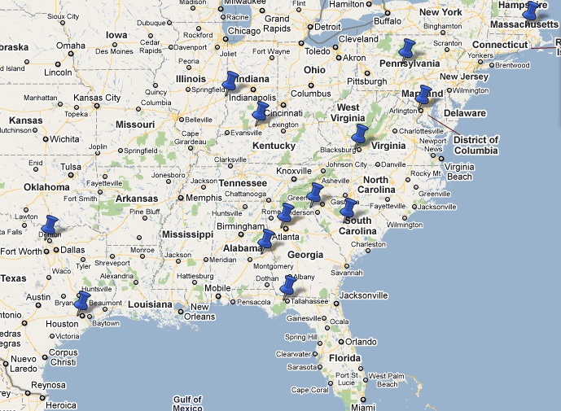
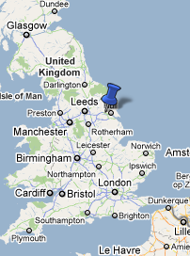
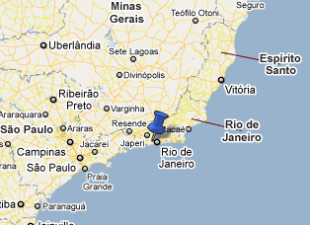
MetaArchive Membership
Current Members
Auburn University
Boston College
Clemson University
Florida State University
Folger Shakespeare Library
Georgia Tech
Indiana State University
Library of Congress
Penn State University
PUC Rio de Janeiro
Rice University
University of Hull
University of Louisville
University of North Texas
University of South Carolina
Virginia Tech
Current Affiliates
NDLTD
SDSC Chronopolis

Slide 11
Chronopolis Basic Facts
Three node federated data grid at UCSD/SDSC, NCAR and UMIACS with capacity for up to 100 TB of data per node (300 TB total)
Using the Storage Resource Broker (SRB) for data management (moving to iRODS)
Using BagIt file packaging format and SRB tools to ingest and transfer data
Using Auditing Control Environment (ACE) for integrity checking
Notes:
DM: slight format changes

Slide 12
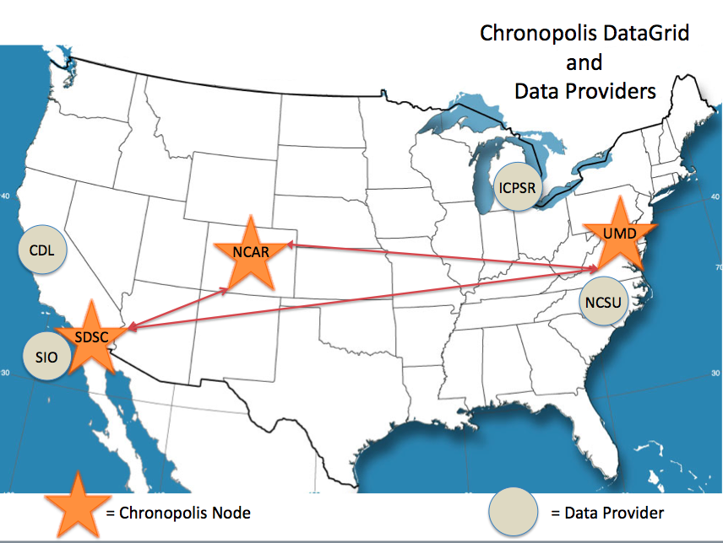
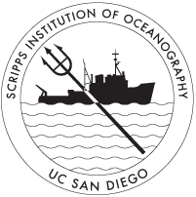
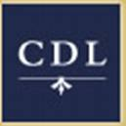

Current Chronopolis collections
Data Providers:
Inter-university Consortium of Political and Social Research –
preservation copy of collections including 40 years of social science data and Census
California Digital Library –
political and government web crawls, Web-at-risk collection
SIO Explorer –
data from 50 years of research voyages
NCSU Libraries --
state and local geospatial data
Spring 2010
http://chronopolis.sdsc.edu
Notes:
DM: changed date on map

Slide 13
Full TRAC certification for Chronopolis
Being conducted by CRL
Doing self-assessment section now
Finishing in early 2011
Really diving back into OAIS
Section 6 “Archive Interoperability”

Slide 14
Distributed Digital Preservation Strengths
Replicated copies stored in geographically diverse locations have a better chance of survival
Can embed preservation infrastructure and knowledge in cultural memory organizations
Can enable multiple instances to be monitored separately (lessens human error and malicious behavior possibilities)
Emphasizes collaboration and trust

Slide 15
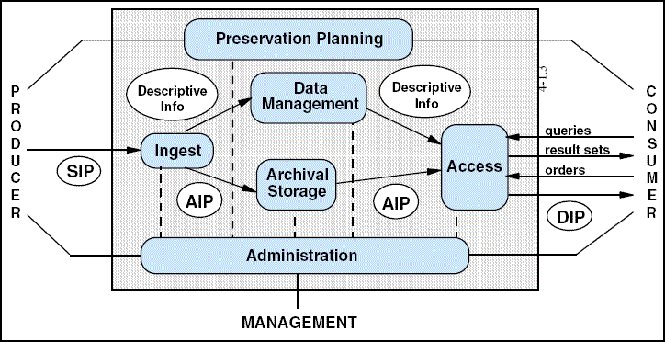
OAIS Reference Model

Slide 16
OAIS Section 6 Headings
Technical Levels of Interaction Between OAIS Archives
  Independent Archives
  Cooperating Archives
  Federated Archives
  Archives with Shared Functional Areas
Management Issues with Federated Archives

Slide 17
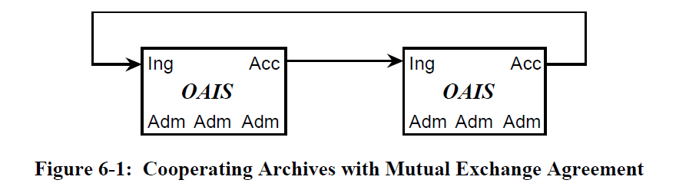
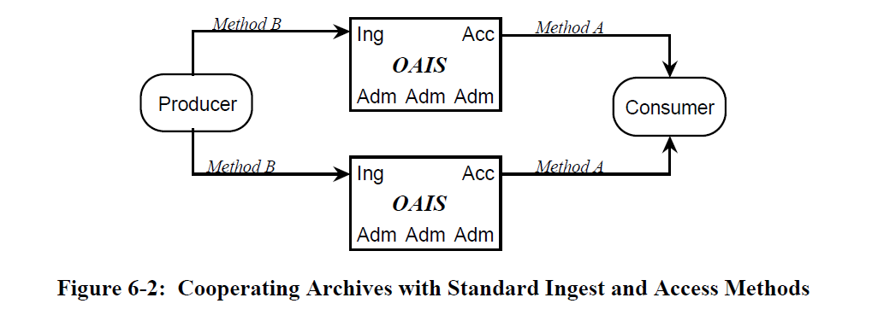
OAIS: Cooperating Archives

Slide 18
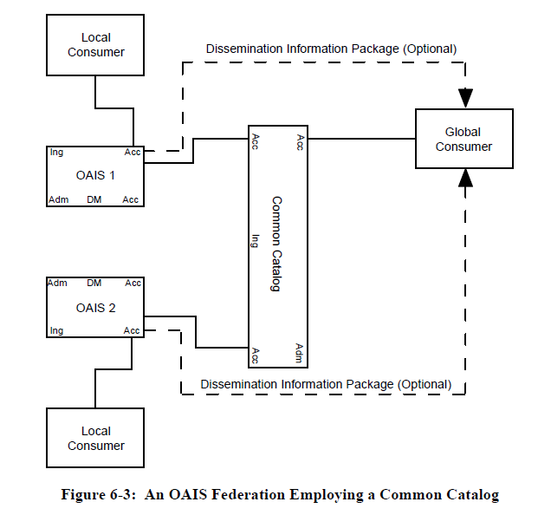
OAIS: Federated Archives

Slide 19
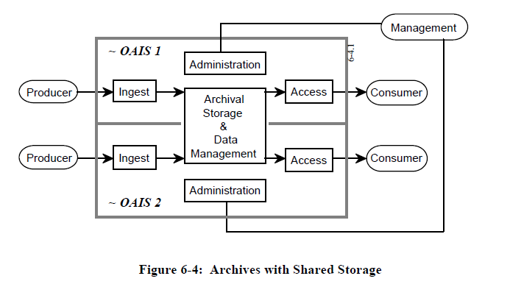
OAIS: Archives with Shared Functions

Slide 20
OAIS on “Autonomy Issues”
“The above examples show that the OAIS model is consistent with federation to accomplish specific objectives.
However, it should also be considered that some of these objectives might be accomplished through voluntary action.
This is an important dimension in the association of systems, including archives, because it establishes the degree of autonomy for each system.
At the heart of the autonomy issue is the ease with which an association may be altered by one of the participants.”

Slide 21
OAIS on Autonomy Issues (cont.)
No interactions and therefore no association (complete autonomy, no linkages)
Associations that maintain an association member’s autonomy (voluntary participation, members can withdraw at will without penalty, ex. Internet sites)
Associations that bind an association member by contract (“The amount of autonomy retained depends on how difficult it is to negotiate the changes. The difficulty may rise as more entities become a party to the contract.”)

Slide 22
Roles in the Stewardship Network
Committed Content Custodians
Communities of Practice and Information Exchange
Services
Capacity Building
Source: “Since we met last year…” Plenary, Martha Anderson, National Digital Information Infrastructure and Preservation Program Annual Partners Meeting 2008
22
Notes:
Source: “Since we met last year…” Martha Anderson, National Digital Information Infrastructure and Preservation Program Annual Partners Meeting 2008
Martha: “I would like to credit our colleague, Caroline Arms, who retired this year with this representation of the roles and participation patterns within a stewardship, or preservation, network. Notice the colored disks. Some appear in all four layers, others in one or two layers. Some organizations will function in a single layer, such as the services layer. Others like libraries, may function as content custodians and also within a community of practice sharing information about content, tools and standards.”

Slide 23
DDP and Organizational Questions
  With whom are agreements made?
  What happens if a replication site drops out?
  Tracking who has curatorial responsibility (is it transferred? To the network or to individual repositories)?
  What data management is handled by the Producer and what is handled by the Repository?
  When needed, which copy becomes the most appropriate Dissemination Information Package (DIP)?

Slide 24
DDP and Technical Questions
  Repository relationships
    P2P, hub and spoke, data grid, other
  Security
    How assess security of each repository? Of the network?
  Preservation metadata
    Where has a copy lived? Where are others? Are all equal?
  Copies, copies, copies
    How many copies are enough? What if they don’t match? What if content changes?

Slide 25
Gap Analysis of What the Field Lacks Right Now
Analysis / abstracted model for distributed digital preservation:
  Peer-to-peer roles
  Hub-and-spoke styled preservation relationships
  Centrally orchestrated
Ingestion pathways
Contingent elements

Slide 26
DDP Models, use cases, vocab
We need models that build on the OAIS, but focus on inter-organizational Distributed Digital Preservation alliances, systems, and strategies
Such models should abstract the functions and logical potential relationships between entities seeking to work together to further digital preservation aims
These models should inform collaborative efforts between different groups seeking to preserve digital information
They should also provide a common vocabulary for interoperable systems development

Slide 27
DDP Models and Use Cases
Planning Meeting
A cluster of DDP organizations including MetaArchive, Chronopolis, and others are considering a collaborative project to develop OAIS-based DDP models and use cases
Are in conversations with LC and other agencies about hosting an initial planning meeting to study this issue
If you are interested, please contact us

Slide 28
Questions for Discussion
Layers/types of organizations to understand:
  Varieties of Repositories
  Varieties of Content Creators
  Varieties of Networks
Types of interactions to understand:
  Collection exchange (for preservation or access?)
  Collection enhancements/remediation (metadata, content additions, other?)

Slide 29
Contact
Martin Halbert
martin.halbert@unt.edu
Katherine Skinner
katherine.skinner@metaarchive.org
David Minor
minor@sdsc.edu

