Slide 1


Slide 2
Background

Slide 3
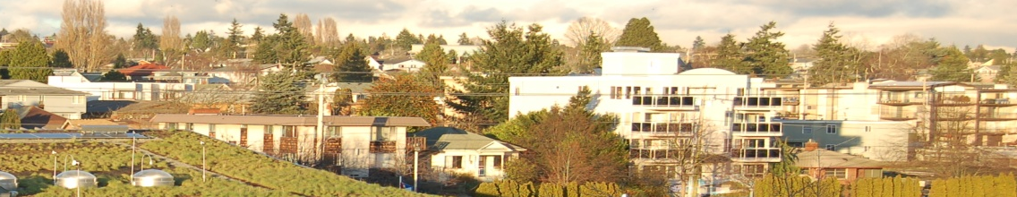





Chronopolis Goals
Data Grid supporting a
Long-term Preservation Service
Data Migration
to next generation
technologies
Replication
of data at multiple,
geographically
distinct sites
Trust
Agreements
between sites
Data Providers
(Data repositories, libraries, etc.)
UCSD Libraries

Slide 4
Chronopolis: Basic Facts
Based on a 3-node federated data grid at geographically separate sites
Current capacity of up to 50 TB of data per node (150 TB total)
Using Storage Resource Broker (SRB) for data management
Using BagIt and SRB protocols to transfer data
Using several monitoring tools: Auditing Control Environment (ACE), SRB Replication Monitor, SRB System Monitor
Analyzing metadata that is created by the various parts of the system
Writing best practices documents for clients and partners

Slide 5
Chronopolis Management
Chronopolis is being developed by a national consortium led by SDSC and the UCSD Libraries.
Initial Chronopolis nodes include:
  SDSC and the UCSD Libraries
  at UC San Diego
  University of Maryland Institute for Advanced Computer Studies (UMIACS)
  National Center for Atmospheric Research (NCAR) in Boulder, CO
UCSD Libraries

Slide 6
SDSC
Founded in 1985 with a $170 million grant from the National Science Foundation's Supercomputer Centers program, SDSC is an organized research unit of the University of California, San Diego
Its staff of more than 300 includes professionals in multidisciplinary science and technology including software development; data management, analysis and preservation; visualization; high-end computing; and code optimization for a variety of scientific applications
SDSC is a founding member of the the TeraGrid, a multi-year effort to build and maintain the world's most powerful and comprehensive distributed computational infrastructure for open scientific research.

Slide 7
NCAR

Slide 8
UMIACS
Interdisciplinary research institute with a broad range of research programs at the interface between computer science and other disciplines
Annual budget around $25M, primarily coming from NSF, DoD, NASA, NIH, and Industry
Over 65 faculty from Computer Science, Engineering, Information Sciences, Linguistics, Life Sciences, and Social Sciences.

Slide 9

Chronopolis Lessons
Complexities of multi-organizational model
  MOUs, SLAs, multiple business offices, etc
Benefit of staff – breadth and
depth as well as redundancy
Wider palette of tools and
diversity of infrastructure

Slide 10
Membership

Slide 11
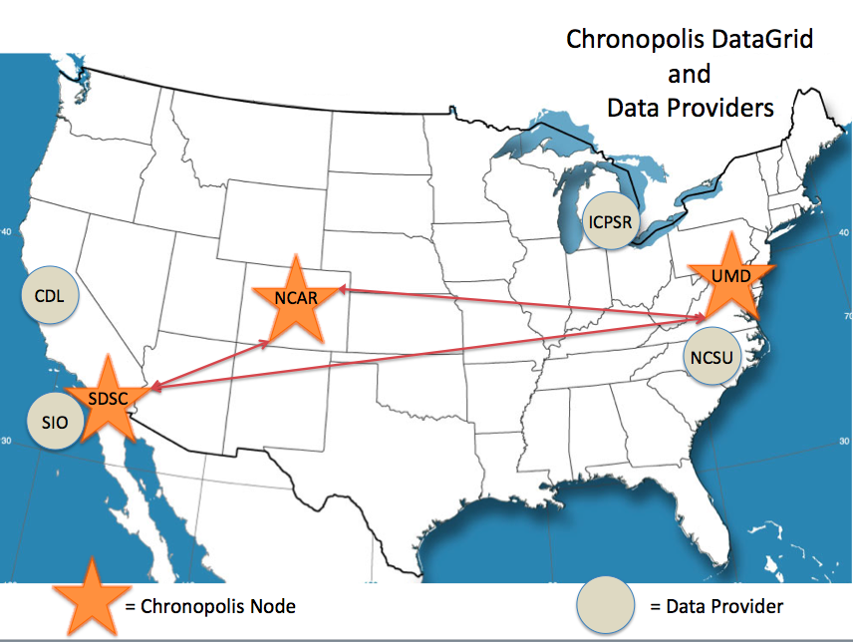

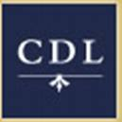

Current Chronopolis collections
Data Providers:
Inter-university Consortium of Political and Social Research –
preservation copy of all collections including 40 years of social science data and Census
California Digital Library –
political and government web crawls, Web-at-risk collection
SIO Explorer –
data from 50 years of research voyages
NCSU Libraries --
State and local geospatial data
March 2009
http://chronopolis.sdsc.edu

Slide 12
New collections and customers
We’re looking for new customers!
What kinds of users?
  Chronopolis is:
    Large in scale
    Not designed as an access system
    Agnostic to content

Slide 13
New nodes
We’re looking (possibly) for new nodes!
Who would want to join?
  Organizations which see the value in geographic replication
  Organizations which have some expertise/infrastructure but not the whole enterprise
Why would they want to join?
  Gain large preservation environment
  New working relationships with other communities (possibly geographically-based)

Slide 14
Extensibility versus Cloning

Slide 15
Advice
Don’t re-invent the wheel:
  Use existing tools and processes
Focus on your targeted, unique collections:
  Local content
  Shared collection foci
Understand the underlying technologies and which would be of benefit (e.g. SRB, BagIt, ACE)

Slide 16
Thanks

