Slide 1
Update 2009:
Blue Ribbon Task Force on Sustainable Digital Preservation and Access
Fran Berman (SDSC/RPI) and Brian Lavoie (OCLC)
BRTF-SDPA Co-Chairs
Abby Smith
Editor, BRTF-SDPA Final Report

Slide 2
Blue Ribbon Task Force Goal
Frame digital preservation and access as a sustainable economic activity
  Economic activity → deliberate allocation of resources
  Sustainable → ongoing resource allocation over long periods of time
Articulate the problem/provide practical recommendations, guidelines, etc.

Slide 3
Economic Sustainability
Economically sustainable digital preservation requires:
  Recognition of benefits
  Incentives for decision-makers to act
  Selection
  Mechanisms to support ongoing, efficient allocation of resources
  Appropriate organization and governance
Target Audience: Decision Makers
Scope: Digital Materials for which there is a clear public interest

Slide 4
BRTF-SDPA Charge
To conduct a comprehensive analysis of previous and current efforts to develop and/or implement models for sustainable digital information preservation
To identify and evaluate best practice regarding sustainable digital preservation among existing collections, repositories, and analogous enterprises
To make specific recommendations for actions that will catalyze the development of sustainable resource strategies for the reliable preservation of digital information
Provide a research agenda to organize and motivate future work.

Slide 5
BRTF-SDPA Participants
Blue Ribbon Task Force:
Paul Ayris, University College London
Fran Berman, SDSC/UCSD
Bob Chadduck, NARA Liaison
Sayeed Choudhury, Johns Hopkins University
Elizabeth Cohen, AMPAS/Stanford
Paul Courant, University of Michigan
Lee Dirks, Microsoft
Amy Friedlander, CLIR
Chris Greer, NITRD Liaison
Vijay Gurbaxani, UC Irvine
Anita Jones, University of Virginia
Ann Kerr, Consultant
Brian Lavoie, OCLC
Cliff Lynch, CNI
Dan Rubinfeld, UC Berkeley
Chris Rusbridge, DCC
Roger Schonfeld, Ithaka
Abby Smith, Consultant
Anne Van Camp, Smithsonian
Sponsoring Agencies/Institutions:
National Science Foundation
Mellon Foundation
Library of Congress
National Archives and Records Administration
CLIR
NITRD
JISC
Member institutions
Specific Responsibilities
Fran Berman / co-Chair
Amy Friedlander / Interim Report Editor
Ann Kerr / January Panel Rapporteur
Brian Lavoie / co-Chair
Susan Rathbun / Task Force Support
Abby Smith / Final Report Editor
Jan Zverina / Communications Lead
Sylvia Spengler/ NSF Program Officer
Don Waters / Mellon Program Officer
Laura Campbell, Martha Anderson / LC representative

Slide 6
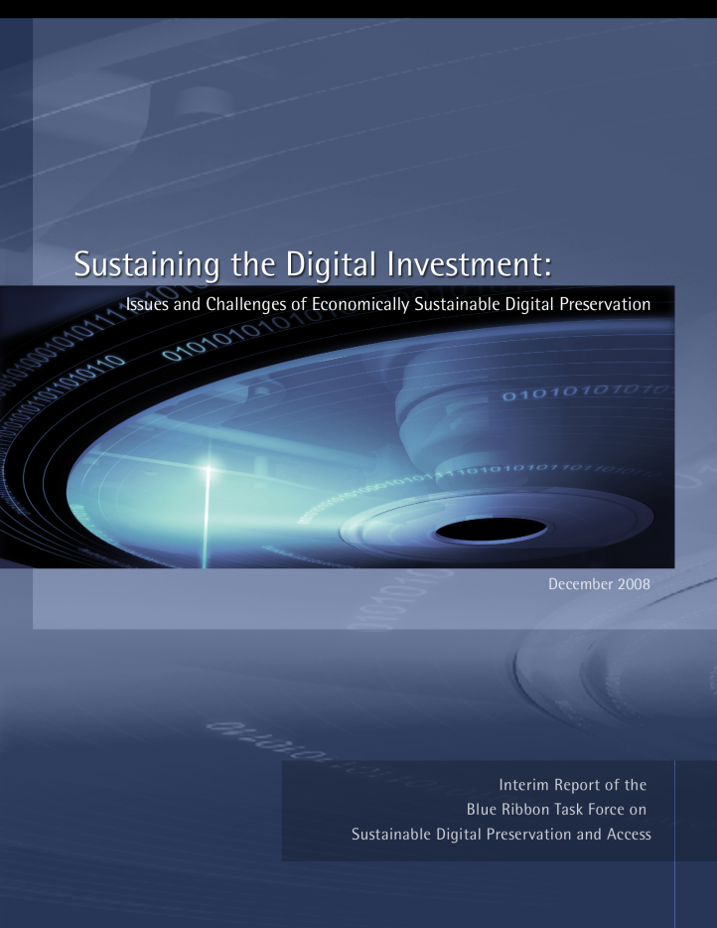
Task Force Interim Report
(Released December 2008)
Goals:
  Describe past and current approaches to economic sustainability
  Identify points of convergence/divergence; “lessons learned”
  Articulate what we know so far, and what the key knowledge gaps are
Interim Report Editor: Amy Friedlander
Sustaining the Investment:
Issues and Challenges of Economically Sustainable Digital Preservation
http://brtf.sdsc.edu/biblio/BRTF_Interim_Report.pdf

Slide 7
Key Observations
Systemic challenges create barriers for sustainable digital access and preservation
  “One-time” funding models are inadequate to address persistent long-term access and preservation needs.
  Poor alignment between stakeholders in the digital preservation and access world and their roles, responsibilities and support models.
  Lack of institutional, enterprise, and/or community incentives to support the collaboration needed to enforce sustainable economic models.
  Complacency that current practices are “good enough.” Both “carrots,” in the form of recognition that access to information is an investment in current and future success, and “sticks,” in the form of penalties for non-compliance, accounting of explicit opportunity costs, or costs of lost information are needed.
  Fear that digital access and preservation is too big to take on.

Slide 8
Lessons Learned from Current Practice
It is easier to sell “outcomes” (e.g. persistent access) than processes
(e.g. preservation).
Don’t oversell the future.
The benefits of digital preservation are a matter of current as well as future interest
Separating preservation costs from other costs is difficult.
No clear distinction between process of “making things available now” vs. “making things available in the future”
Diversity of funding streams is important
Non-monetary incentives are important.
Corporate recognition and reputation enhancement are also incentives
Consider the full range of options when selecting an economic model to support digital preservation.
Think out of the box: Public-spirited, mission-driven institutions sometimes resistant to monetizing and charging for a “social good”

Slide 9
Further Work Required
Survivability
  Ability to survive threats, accidents, attacks, and other causes of possible data loss
Recovery
  Ability to reinstate systems after failure; ability to assess and reconstruct damaged data
User and institutional responsibility in the preservation process
  Behavior shift for users and institutions to incorporate data curation and data life cycle management as part of normal professional activities
Privacy
  What is the right tension between privacy and accessibility? How should it be enforced for various scenarios?

Slide 10
2009-2010: Final Year Activities
BRTF Quarterly Meetings: July, 2009 and October, 2009. Focus is on the Final Report.
Outreach by TF members to domain communities: 2009-2010
Final Report Release: ~ January 2010
U.S. Symposium on Digital Preservation and Economic Sustainability: Spring 2010
U.K. Symposium on Digital Preservation and Economic Sustainability: Spring 2010

Slide 11
Key Deliverable for Year 2:
BRTF Final report
Represent digital preservation as set of economic factors and conditions that impact sustainability
Economic Framework
Real World
Scenarios
Based on a particular set of economic factors and conditions, identify and understand the economic implications in terms of prospects for long-term sustainability
Economic Analysis
Sustainability
Definition
Based on economic analysis, provide practical recommendations for eliminating or mitigating weaknesses or risks for achieving sustainability
Recommendations

Slide 12
Four generalized scenarios
Primary Research Data
(e.g., data sets)
By researchers
For researchers
Secondary Research Inputs
(e.g., e-journals)
By researchers
For researchers
Open Web Content
(e.g., blogosphere)
By … everyone
For … everyone?
Commercially-owned
Cultural Materials
(e.g., movie studio output)
By private entities
For privately controlled purposes

Slide 13
Economic framework
Describe a digital preservation activity in terms of
essential elements relevant for thinking about long-term
economic sustainability
CORE ATTRIBUTES
Intrinsic to all d.p. activities
Identified by our econ experts
Digital
Preservation
Activity
DOMAIN-SPECIFIC ATTRIBUTES
Apply in some (not all) d.p. activities
Identified by our domain experts
CHOICES
For decision-makers/stakeholders
Identified by our domain experts

Slide 14
Abstract the essentials …
Real-World
Scenario X
Core Attribute 1 Derived demand
Core Attribute 2 Depreciable durable good
Core Attribute 3 Nonrivalrous consumption
Core Attribute 4 Temporally dynamic
path-dependent
Domain-specific attribute 1
Domain-specific attribute 2
…
Choice 1
Choice 2
…

Slide 15
Economic sustainability: problem space
Demand-side
VALUE
Supply-side
INCENTIVES
Beneficiaries
Providers
Process
SELECTION
ONGOING/EFFICIENT RESOURCE ALLOCATION
ORGANIZATION/
GOVERNANCE
Digital Preservation
Activity

Slide 16
Real world to theory to recommendations
Framework (core attributes, domain-specific attributes, choices) provides:
  Template for organizing key information from real world digital preservation scenarios …
  … to which we can apply economic theory/insight to isolate important implications …
  … from which we can derive practical recommendations/guidelines for our final report

Slide 17
Key Deliverable for Year 2:
BRTF Final report
Represent digital preservation as set of economic factors and conditions that impact sustainability
Economic Framework
Real World
Scenarios
Based on a particular set of economic factors and conditions, identify and understand the economic implications in terms of prospects for long-term sustainability
Economic Analysis
Sustainability
Definition
Based on economic analysis, provide Practical recommendations for eliminating or mitigating weaknesses or risks for achieving sustainability
Recommendations

Slide 18
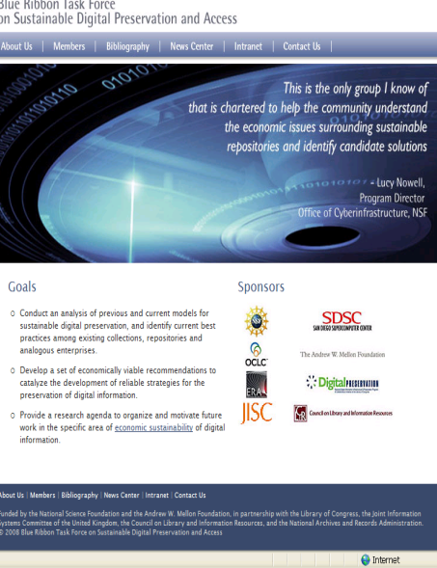
For More Information
BRTF Website: brtf.sdsc.edu
  Interim Report
  Preservation Bibliography
  Task Force Information
  Upcoming Final Report, etc.

